Slide 1
Leadership Perspectives Instructions
This activity works on a computer/laptop, not a mobile device (phone, tablet)
Go to https://tinyurl.com/y95akflv
Complete 3 stages in one sitting by midnight Sun. Aug. 20 (no saving to come back later)
1. Go with your Gut sorting of leadership statements
2. Think it Through sorting of leadership statements
3. Explain WHY —print out pdf to bring to class Aug. 22

Slide 2
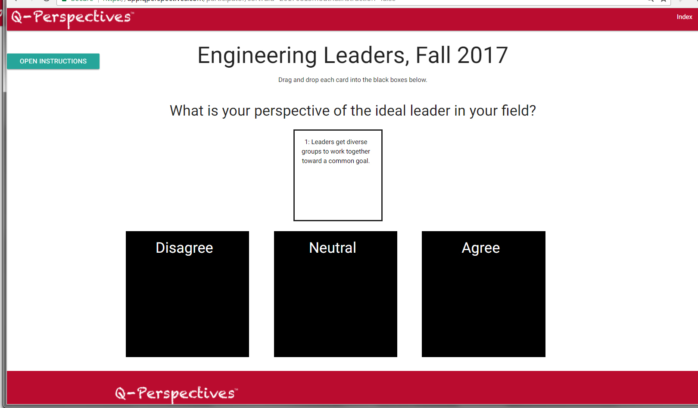
Stage 1: Go with your Gut
Quickly read each of 36 “cards”
Then drag and drop each card to box that best describes an ideal leader in your field.

Slide 3
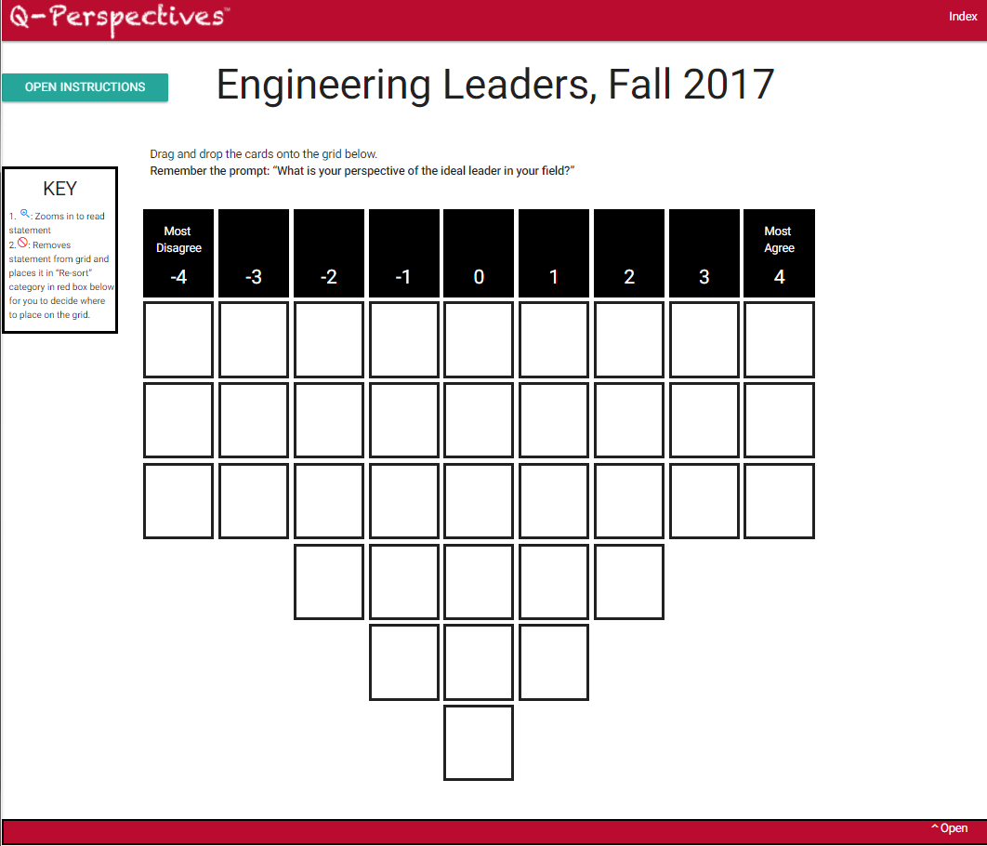
Stage 2: Think it Through
On larger grid, think through your perspective on each statement more carefully.
Click “Open” to see statement cards.

Slide 4
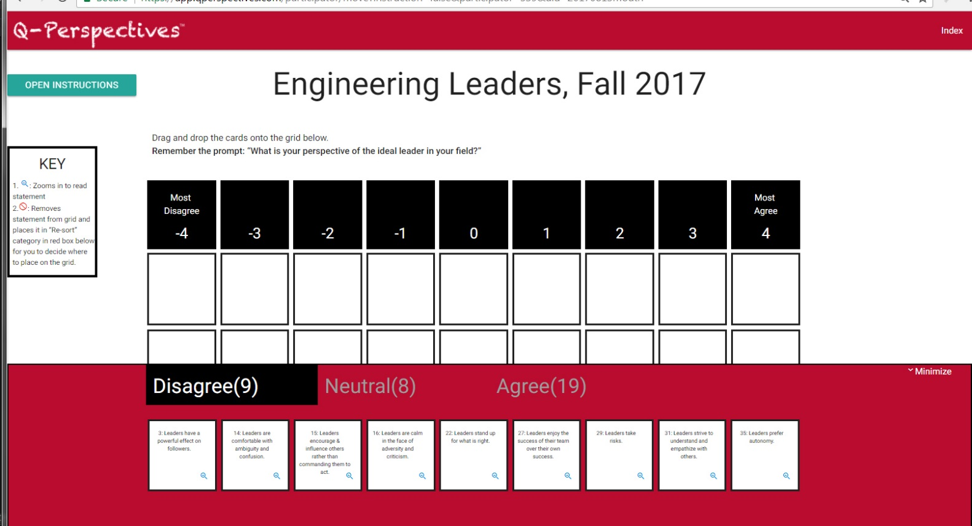
Stage 2: Think it Through
Drag and drop each card onto the larger grid along the continuum of -4 (Most Disagree) to +4 (Most Agree)
Click “Minimize” to see the full grid.

Slide 5
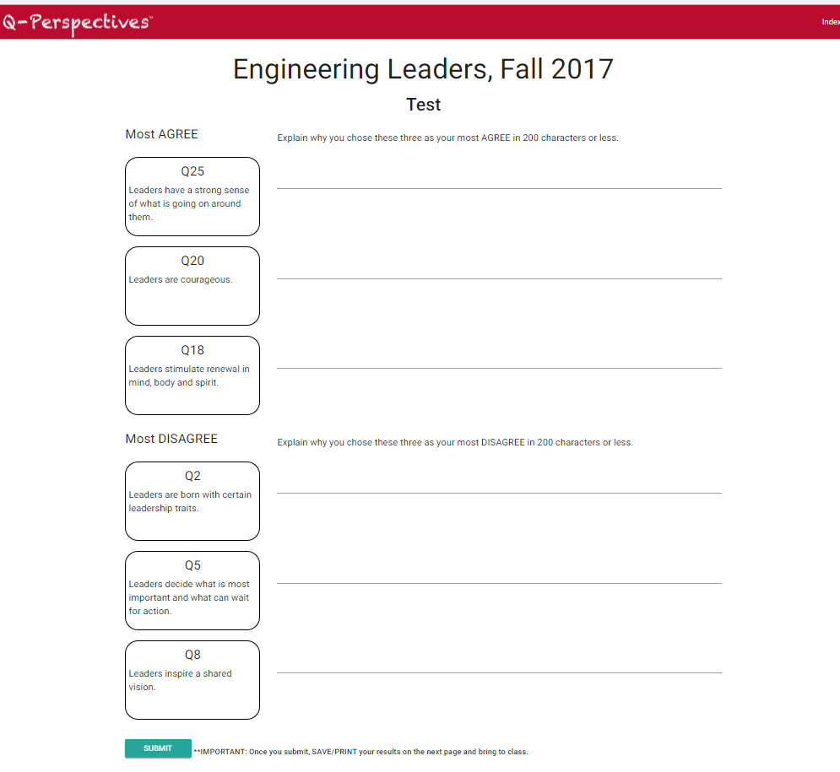
Stage 3: Explain WHY for the +4 and -4 choices. This will generate a pdf of your responses. Print and bring to class.

Slide 6
IMPORTANT:
Use computer/laptop, NOT mobile device
Complete by midnight Sunday, Aug. 20
Print pdf that is generated at the end and bring to Aug. 22 class
Approximate time to complete: 20 minutes
THANKS!

